Slide 1


Moodle++
Sign Up Log In
Be great via Implicit learning
To make old traditional way of learning easier to absorb and interactive !
Lets get Started

Slide 2
Moodle++
Sign Up Log In
Create your Moodle++ account now
Use your Moodle email to sign up
First name
Surname
Email
Password
Confirm Password
Create

Slide 3
Moodle++
Sign Up Log In
Log in
Email
Password
Log in

Slide 4


Moodle++
Sign Up Log In
Create Quiz
Continue

Slide 5





Moodle++
Sign Up Log In
Insert Players
Add
Start!

Slide 6
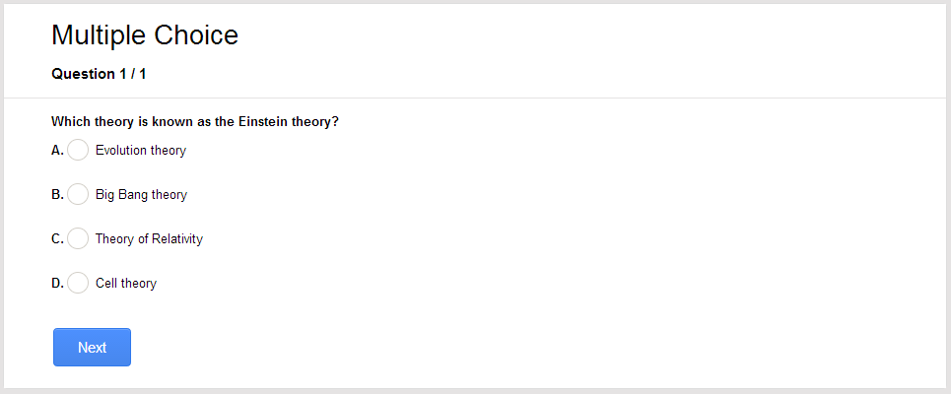
Moodle++
Sign Up Log In
Question 1/5

Slide 7
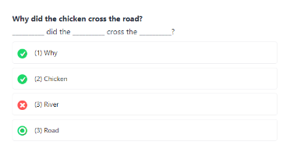
Moodle++
Sign Up Log In
Question 2/5

Slide 8
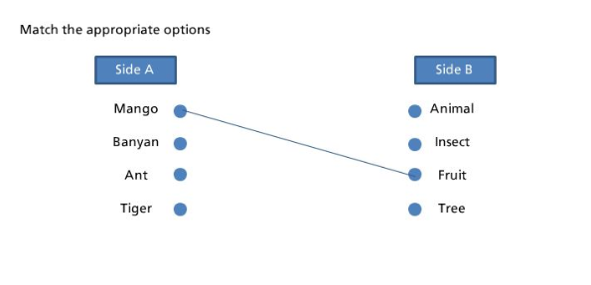
Moodle++
Sign Up Log In
Question 3/5

Slide 9
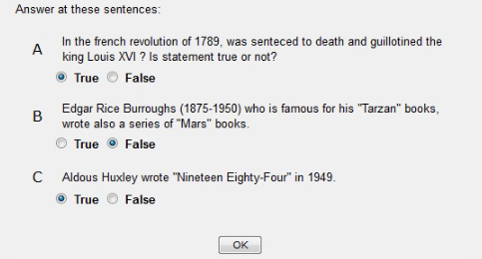
Moodle++
Sign Up Log In
Question 4/5

Slide 10
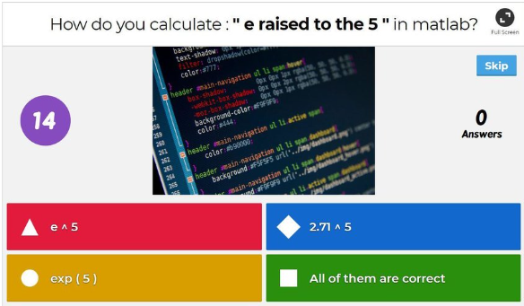
Moodle++
Sign Up Log In
Question 5/5

Slide 11
Moodle++
Sign Up Log In
Create Quiz
Continue

